Slide 1
Breathing Emergencies & Barriers
Lesson Ten

Slide 2
Breathing Emergencies
Introduction
Has anyone choked on an object, or witnessed someone else choking?
What did you notice?
What did you do?
What was done?

Slide 3
Breathing Emergencies
Students will be able to :
Identify signs and symptoms of a breathing emergency
Learn how to care for a breathing emergency
Practice providing care for a conscious choking victim

Slide 4
Breathing Emergencies
Terminology
Hyperventilation
Rapid shallow breathing caused by physical or emotional trauma.
May cause tingling / numbness into fingers and toes

Slide 5
Breathing Emergencies
What are some causes of Breathing Emergences?
Asthma or other disease/illness
Choking on food or object
Allergic reaction
Injury – related
Hyperventilation

Slide 6
Breathing Emergencies
Signs of Choking
Hands at throat
Panicked look on face
Difficulty breathing
Coughing
Can NOT speak or breathe
Change in Skin Color

Slide 7
Breathing Emergencies
If someone is having a breathing emergency, how can you help?
Call 911
Calm victim down
Assist with Rx (medications)
Get obstruction out

Slide 8
Breathing Emergencies
Conscious Choking
2 Types
Partial Obstruction
Complete Obstruction

Slide 9
Breathing Emergencies
What does the body do when an object begins to block the airway?
Begins coughing to expel it
What kind of Obstruction is this?
Is choking a 911/EMS emergency?

Slide 10
Breathing Emergencies
Partial Obstruction
Stand by and encourage them to cough
Be prepared to assist if it becomes a complete obstruction

Slide 11
Breathing Emergencies
How do you know if situation becomes a
Complete Obstruction?
Victim can NOT Speak, Cough or Breathe

Slide 12
Breathing Emergencies
ADULT
CHILD
If situation becomes a
Complete Obstruction
What do you do?
Perform Back Blows
Perform Abdominal Thrusts/Heimlich Maneuver

Slide 13
Breathing Emergencies
ADULT
CHILD
Back Blows
Position self slightly behind person
Place arm across victims chest & grasp opposite shoulder
Place other hand between shoulder blades
Lean victim forward
Give 5 blows with heel of hand between scapula

Slide 14
Breathing Emergencies
ADULT
CHILD
Abdominal Thrusts/Heimlich Maneuver
Stand behind Victim
Make fist
Reach around Victim with both arms
Place fist above Belly Button & grab fist with other hand
5 inward and upward thrusts
Repeat until object comes out

Slide 15
Breathing Emergencies
ADULT
CHILD
Continue rotating between 5 back blows & 5 abdominal thrusts until
Object is expelled
Victim begins coughing
Victim becomes unconscious
EMS arrives on scene

Slide 16
Breathing Emergencies
Modification for a conscious choking child
Get parental permission
Get down to their eye level/kneel down
Less forceful on back blows & abdominal thrusts

Slide 17
Breathing Emergencies
INFANT
INFANT
Back Blows
Position infant face up on your forearm
Sandwich infant between forearms
Support head/neck by holding jaw between thumb & forefinger
Turn infant over to face down position
Place forearm on thigh for support
Give 5 back blows

Slide 18
Breathing Emergencies
INFANT
INFANT
Chest Thrusts
Sandwich infant between forearms
Support head/neck by holding jaw between thumb & forefinger
Turn infant over to face up position
Place forearm on thigh for support
Give 5 chest thrusts – over breast bone – compress ½ to 1 inch

Slide 19
Breathing Emergencies
INFANT
INFANT
Continue rotating between 5 back blows & 5 chest thrusts until
Object is expelled
Infant begins to breathe
EMS arrives on scene

Slide 20
Breathing Barriers
Thought of Mouth to Mouth contact makes many people uncomfortable

Slide 21
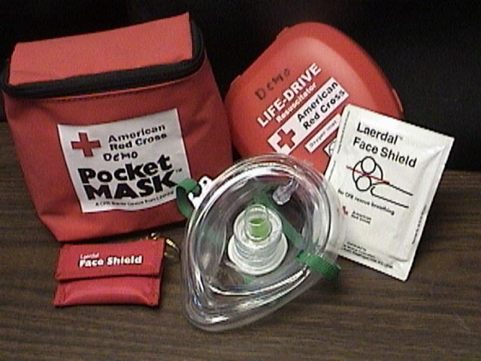
Breathing Barriers
There’s a wide variety of breathing barriers available to first aiders.

Slide 22
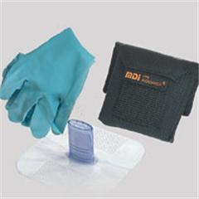
Breathing Barriers
Basic Shields

Slide 23
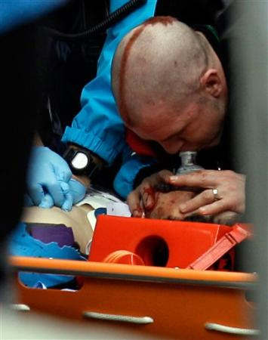
Breathing Barriers
Masks
With 1 way valves

Slide 24
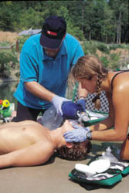
Breathing Barriers
There are Bag Valve Masks

Slide 25
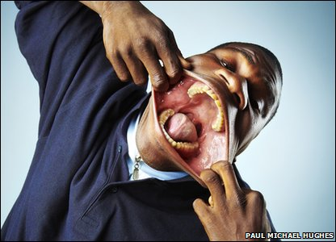
Breathing Barriers
BUT REMEMBER: Diseases are seldom transferred during rescue breathing!!!
Just germs…

Slide 26
Breathing Emergencies
YouTube Videos
Conscious Choking Adult - 4:11 - http://www.youtube.com/watch?v=7m1TSEH7Fas&NR=1
Conscious Choking Child - 4:53- http://www.youtube.com/watch?v=59I7oxfS6vU&feature=related
Conscious Choking Infant - 3:57 - http://www.youtube.com/watch?v=_bBaMWdKqQs&NR=1

Slide 27
Breathing Emergencies
YouTube Videos
TV Ad.
http://www.youtube.com/watch?v=hWt5xt72DRE&NR=1
Student Made
Http://www.youtube.com/watch?v=Apq9RHrwfWs
EMT
http://www.youtube.com/watch?v=wGUNoGjcaaE&NR=1

Slide 28
Breathing Emergencies
YouTube Videos
EMT – What’s wrong?
http://www.youtube.com/watch?v=Aj-XshIGI08
EMT Child conscious choking
http://www.youtube.com/watch?v=ZjmbD7aIaf0&feature=channel
Actor Chokes – Real http://www.youtube.com/watch?v=aOo8KgLTxnk&feature=related

Slide 29
Breathing Emergencies
Get with a partner and perform Conscious Choking Rescues
Adult - Child - Infant
Partial Obstructions
Complete Obstructions

